Slide 1
Game AI

Slide 2
Agenda
Minimax
Alpha Beta Pruning
MCTS
Deep Reinforcement Learning (with Azure ML)

Slide 3
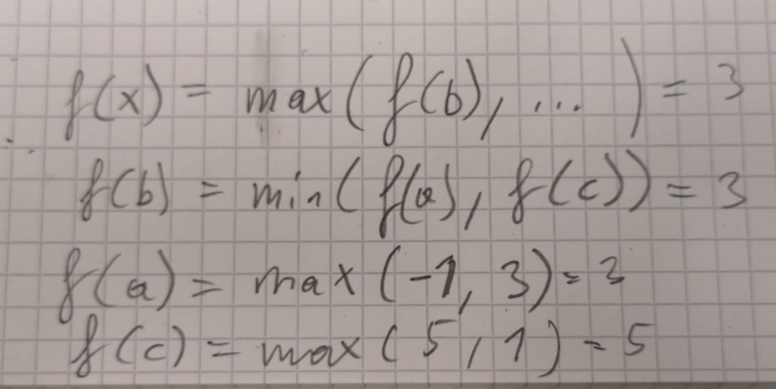
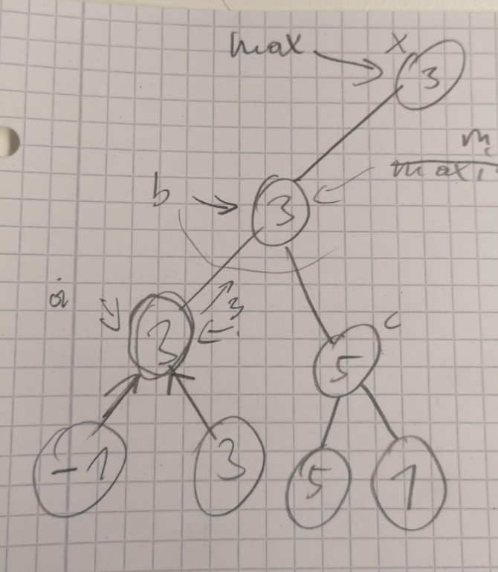
Minimax
Notes:
man muss nur eine funktion f (gameposition, currentplayer) schreiben die jeweils alle moves in einer gameposition auswertet und dann je nach currentplayer das minimum oder das maximum der bewerteten moves zurückgibt.

Slide 4
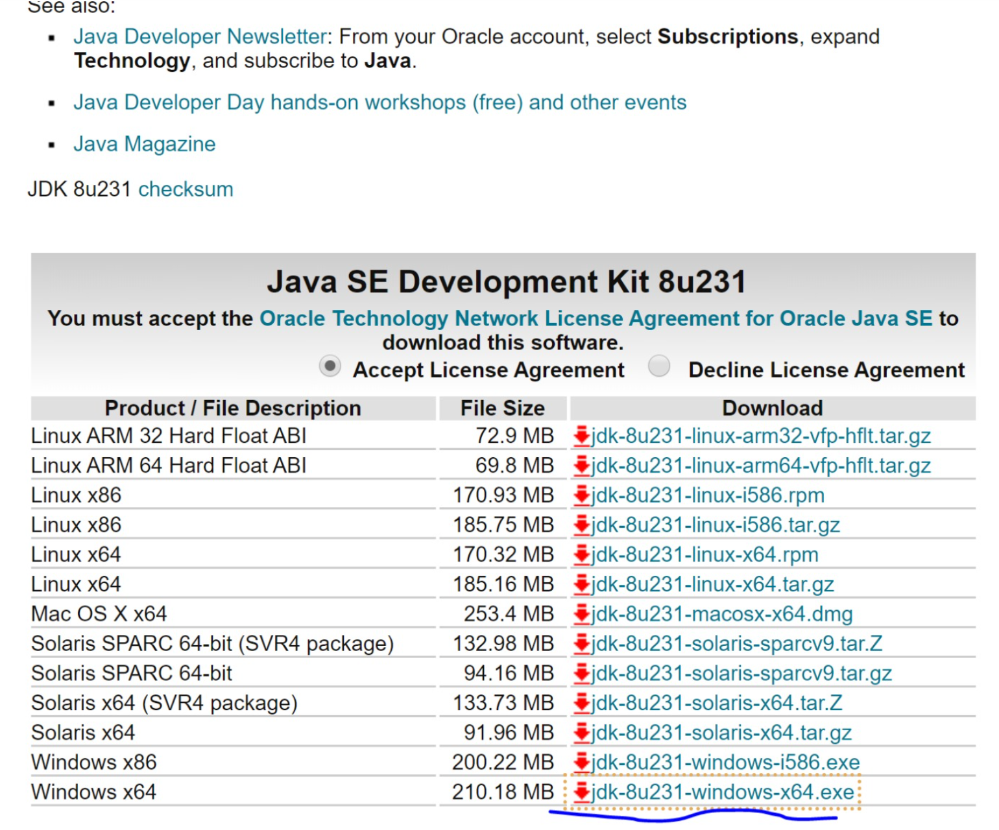
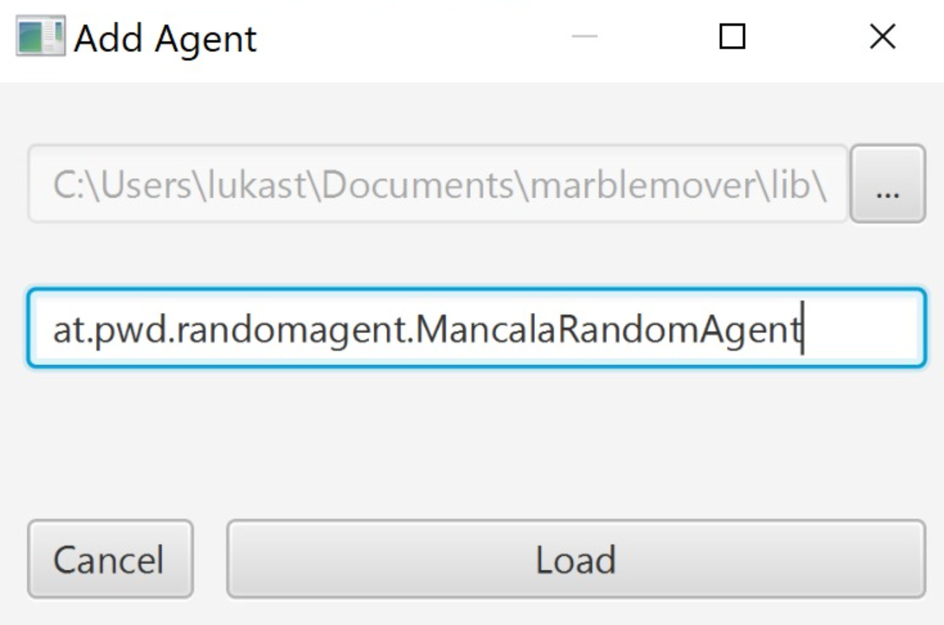
Game of Mancala
https://github.com/metzzo/mancala
Notes:
[08:44, 20.12.2019] Lukas Steindl: habs jetzt auf einem neuen rechner installiert und mal wieder a zeitl braucht bis es überhaupt lauft... zur Doku: man braucht unbedingt das JDK hier: und die JAVA_HOME variable muss auf das installationsverzeichnis dann zeigen exklusive \bin am ende[08:45, 20.12.2019] Lukas Steindl: bzgl. des problems dass er den agent nciht laden kann... ich hab die agent config ganz rauswerfen müssen um es überhaupt starten zu können... d.h im config file muss es zu beginn so aussehen:[08:45, 20.12.2019] Lukas Steindl: <config> <agents/> <computation-time>5</computation-time> <stones-per-slot>4</stones-per-slot> <slots-per-player>4</slots-per-player></config>

Slide 5
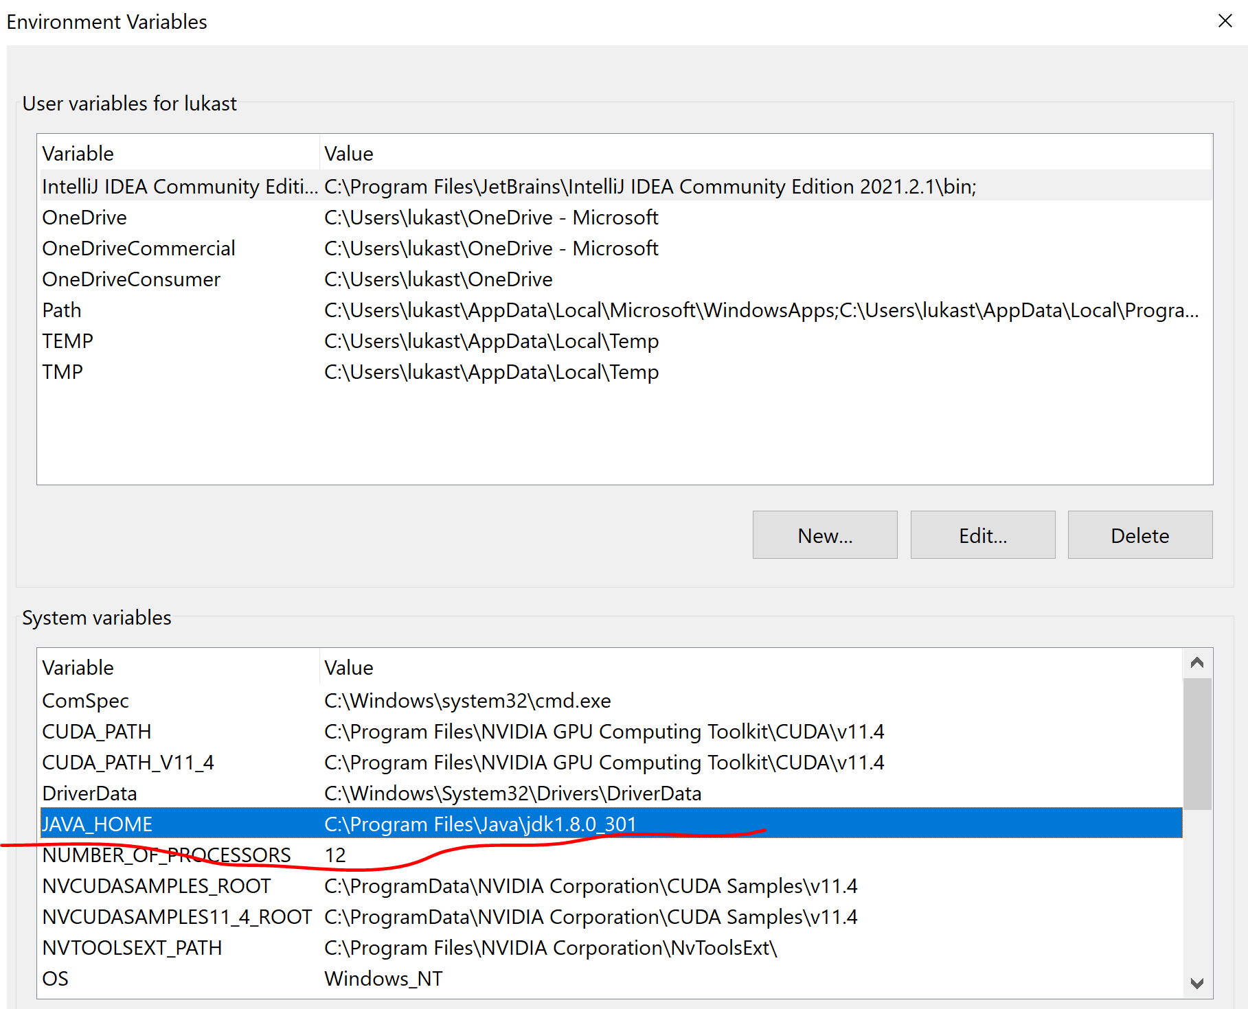
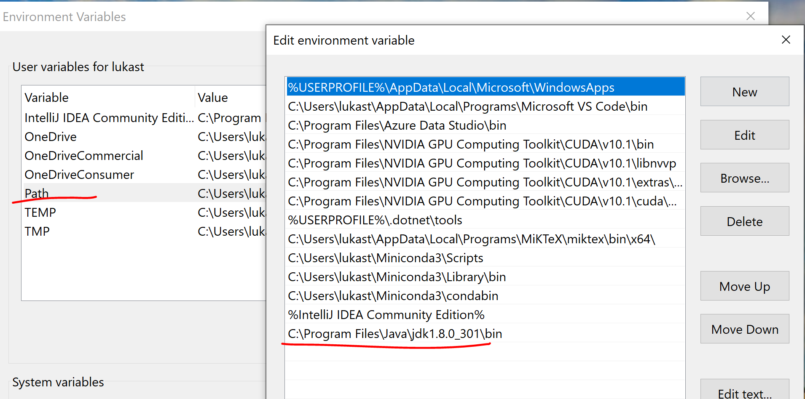
Environment Config

Slide 6
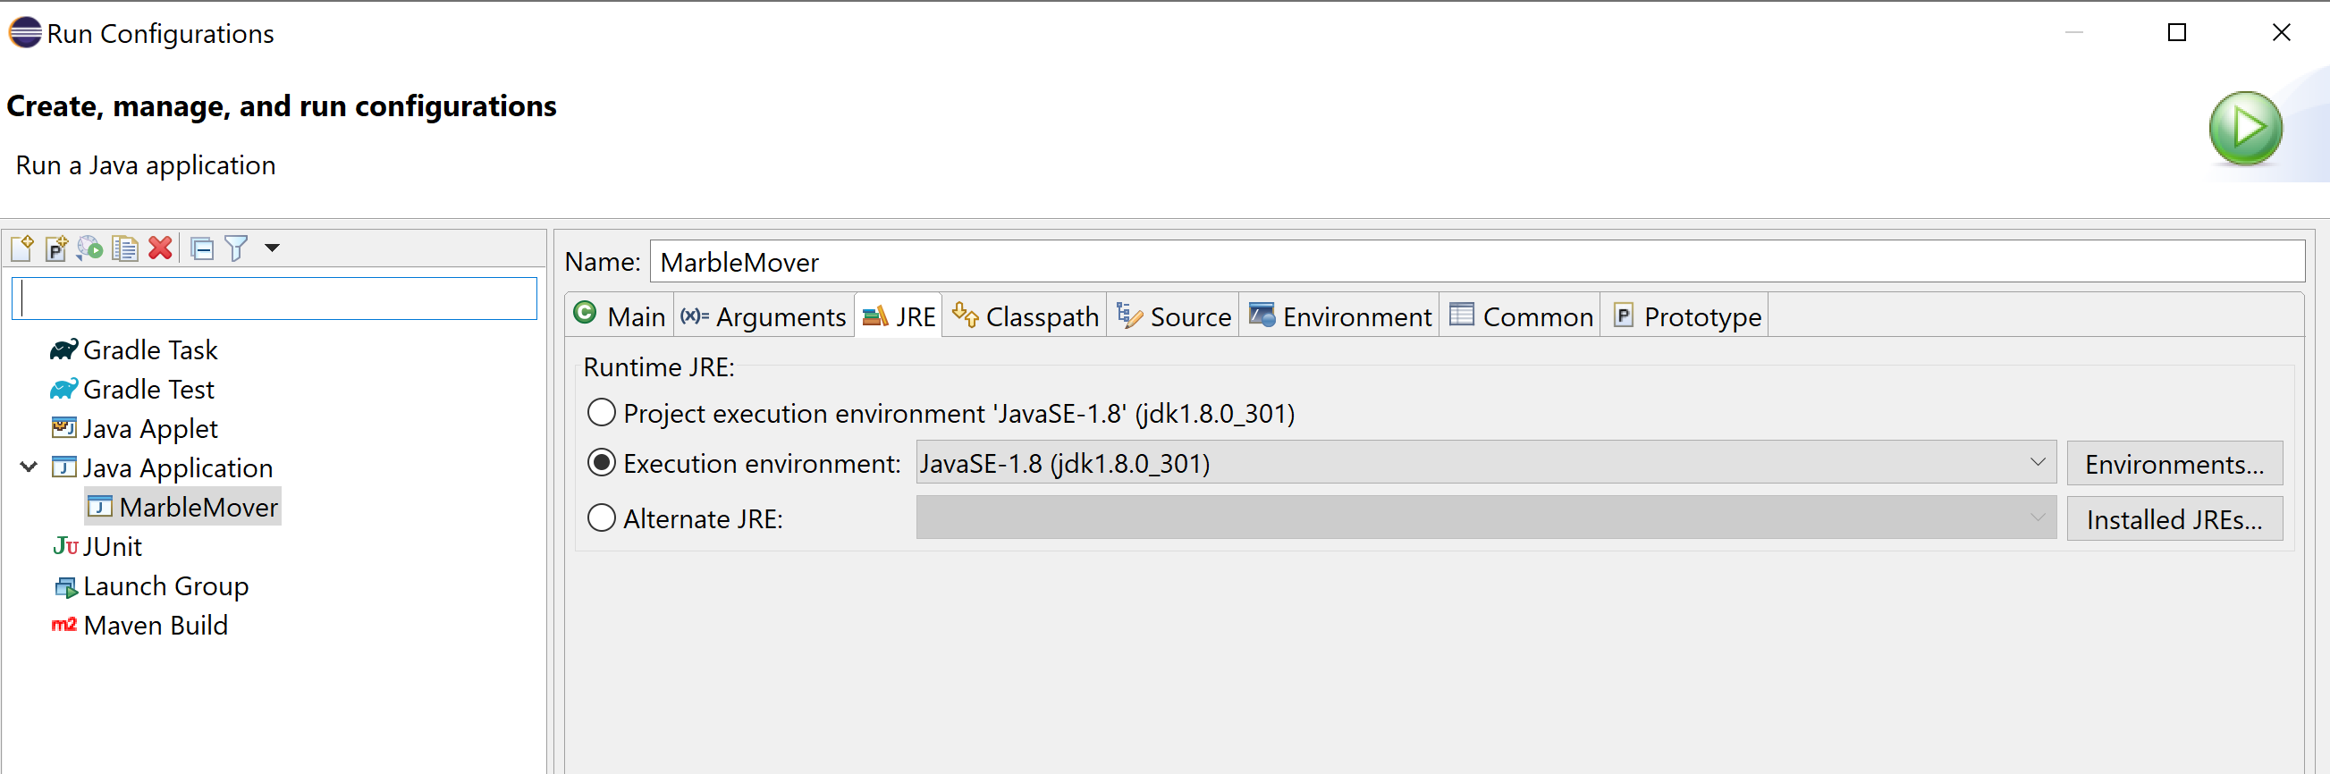
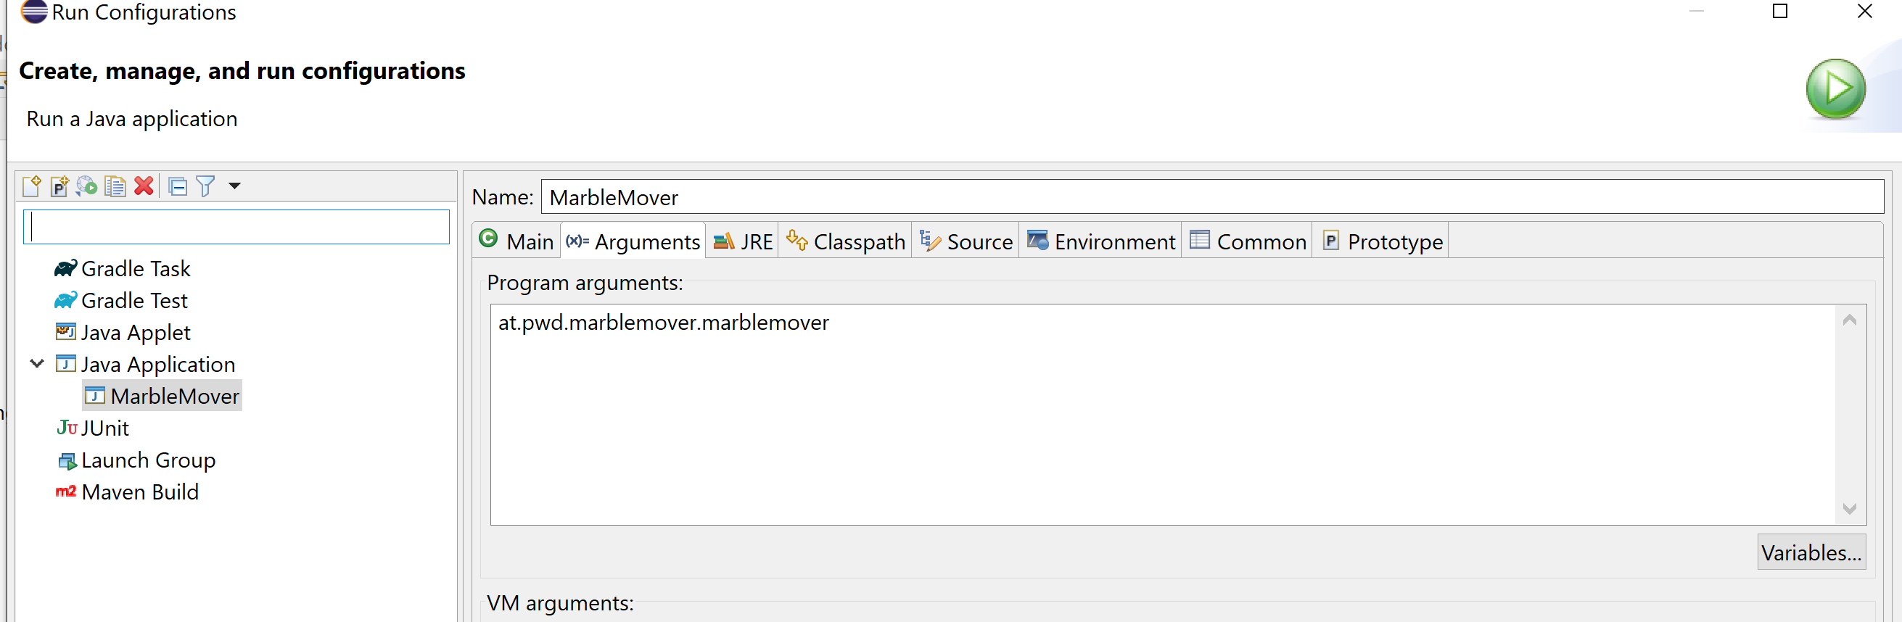
Eclipse Run Configuration

Slide 8
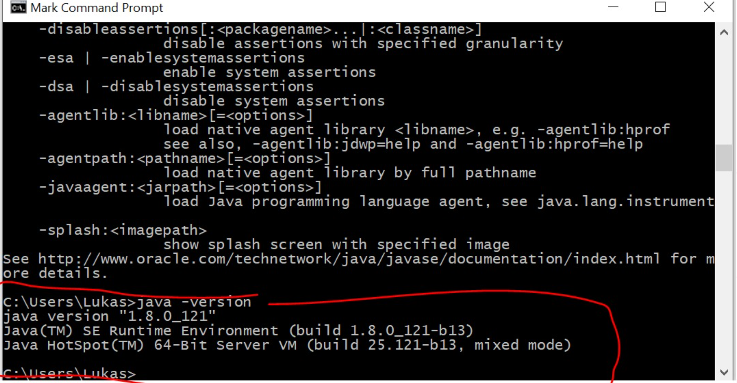
Notes:
Make sure classpath is set so that windows finds java.exe

Slide 9
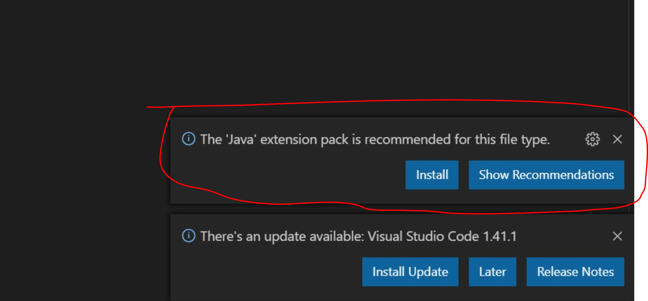
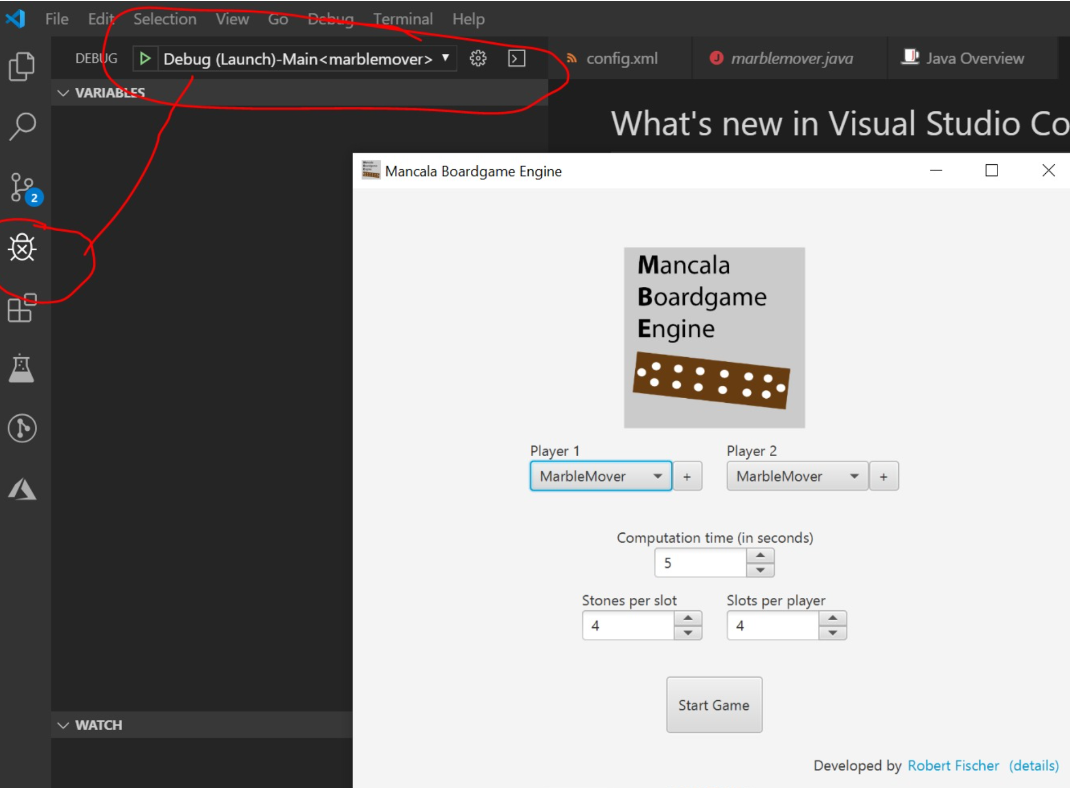
Notes:
ma muss nur diese vs code java extension installieren die er einem vorschlägt wenn man ein java sourcefile öffnet

Slide 10
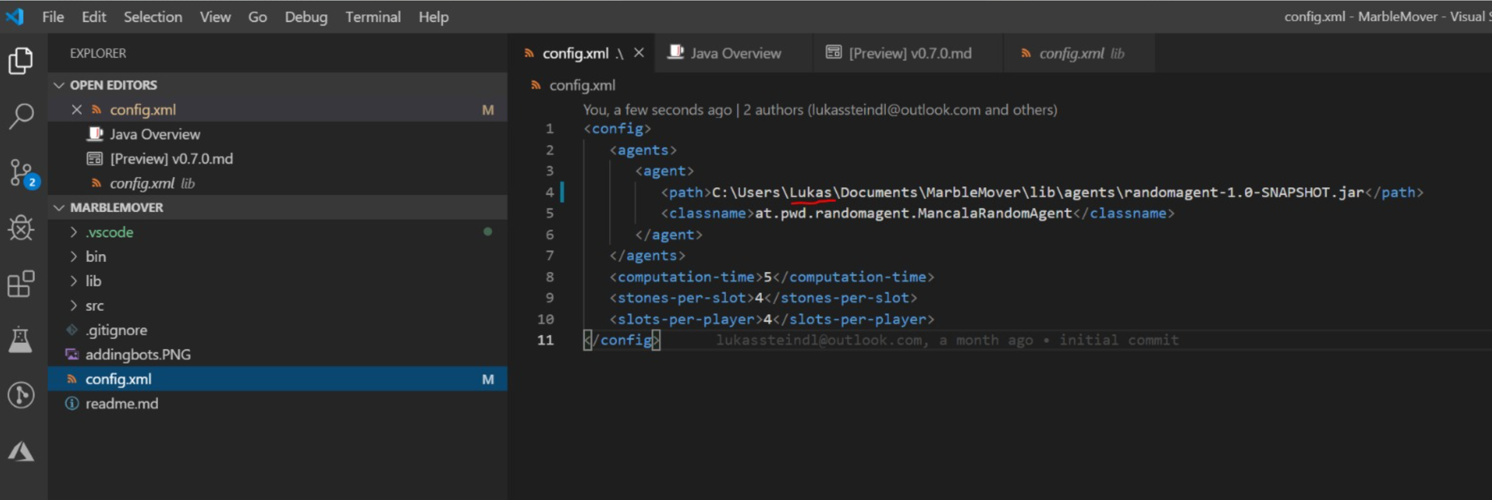

Slide 11
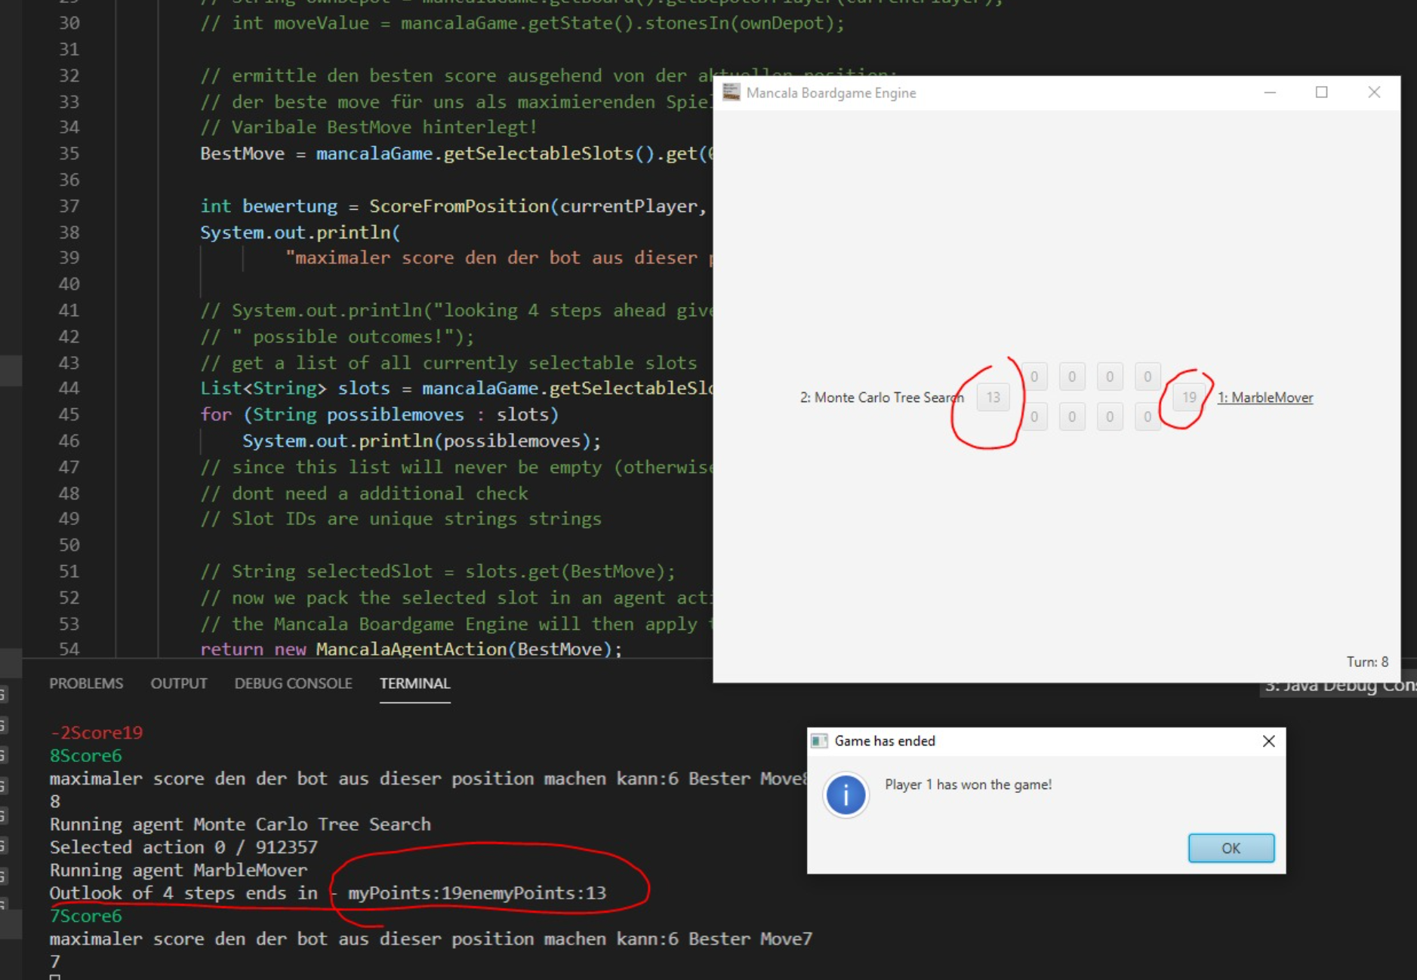
Notes:
Solution:
package at.pwd.marblemover;import java.util.List;import at.pwd.boardgame.game.base.WinState;import at.pwd.boardgame.game.mancala.MancalaGame;import at.pwd.boardgame.game.mancala.MancalaBoard;import at.pwd.boardgame.game.mancala.agent.MancalaAgent;import at.pwd.boardgame.game.mancala.agent.MancalaAgentAction;public class marblemover implements MancalaAgent { public static final String ANSI_RESET = "\u001B[0m"; public static final String ANSI_BLACK = "\u001B[30m"; public static final String ANSI_RED = "\u001B[31m"; public static final String ANSI_GREEN = "\u001B[32m"; public static final String ANSI_YELLOW = "\u001B[33m"; public static final String ANSI_BLUE = "\u001B[34m"; public static final String ANSI_PURPLE = "\u001B[35m"; public static final String ANSI_CYAN = "\u001B[36m"; public static final String ANSI_WHITE = "\u001B[37m"; public String BestMove = ""; @Override public MancalaAgentAction doTurn(int computationTime, MancalaGame mancalaGame) { // wer bin ich? int currentPlayer = mancalaGame.getState().getCurrentPlayer(); // System.out.println(ANSI_GREEN + currentPlayer + ANSI_RESET); // String ownDepot = mancalaGame.getBoard().getDepotOfPlayer(currentPlayer); // int moveValue = mancalaGame.getState().stonesIn(ownDepot); // ermittle den besten score ausgehend von der aktuellen position: // der beste move für uns als maximierenden Spieler wurde dann in der globalen // Varibale BestMove hinterlegt! BestMove = mancalaGame.getSelectableSlots().get(0); int bewertung = ScoreFromPosition(currentPlayer, mancalaGame, 4); System.out.println( "maximaler score den der bot aus dieser position machen kann:" + bewertung + " Bester Move" + BestMove); // System.out.println("looking 4 steps ahead gives" + TotalNumberOfLeaveNodes + // " possible outcomes!"); // get a list of all currently selectable slots List<String> slots = mancalaGame.getSelectableSlots(); for (String possiblemoves : slots) System.out.println(possiblemoves); // since this list will never be empty (otherwise the game would be over), we // dont need a additional check // Slot IDs are unique strings strings // String selectedSlot = slots.get(BestMove); // now we pack the selected slot in an agent action and return it // the Mancala Boardgame Engine will then apply this action onto the slot return new MancalaAgentAction(BestMove); } public int ScoreFromPosition(int currentPlayer, MancalaGame m, int depth) { depth = depth - 1; // init best move to leftmost move int maximumScoreSoFar = -1000000; int minimumScoreSoFar = 1000000; // wenn man auf der Blattebene angekommen ist weil die tiefe erschöpft ist oder // ein spieler gewonnen hat. if (depth == 0 || m.checkIfPlayerWins().getState() != WinState.States.NOBODY) { // hier schauen welcher Spieler wieviele Punkte hätte! MancalaBoard BoardInNMoves = m.getBoard(); String myDepot = BoardInNMoves.getDepotOfPlayer(currentPlayer); String enemyDepot = BoardInNMoves.getDepotOfPlayer(1 - currentPlayer); int myPoints = m.getState().stonesIn(myDepot); int enemyPoints = m.getState().stonesIn(enemyDepot); System.out.println("Outlook of 4 steps ends in - myPoints:" + myPoints + "enemyPoints:" + enemyPoints); return myPoints - enemyPoints; } else { boolean maximizing = false; // color each own move green and each enemy move red. if (m.getState().getCurrentPlayer() == currentPlayer)// { // maximizing maximizing = true; for (String s : m.getSelectableSlots()) { // gib den aktuellen move aus und führe diesen in einer kopie des spiels aus: MancalaGame gamecopy = new MancalaGame(m); // aus dem alphabeta-agent abgeschaut um jeweils den currentplayer in der game // instanz zu setzen boolean moveAgain = gamecopy.selectSlot(s); if (!moveAgain) gamecopy.nextPlayer(); // stell dir vor der nächste schritt ist der letzte... dann erhält man aus der // funktion einen positiven wert wenn der aktuelle bot mehr punkte als der // gegner hat! int currentScore = ScoreFromPosition(currentPlayer, gamecopy, depth); if (maximizing) { System.out.println(ANSI_GREEN + new String(new char[(depth - 3) * -1]).replace("\0", "-") + s + "Score" + currentScore + ANSI_RESET); } else { System.out.println(ANSI_RED + new String(new char[(depth - 3) * -1]).replace("\0", "-") + s + "Score" + currentScore + ANSI_RESET); } // take maximum score from position as current return value: // wenn man maximierender spieler ist, wählt man den move der den höchsten // positiven wert liefert! if (currentScore > maximumScoreSoFar) { maximumScoreSoFar = currentScore; if (depth == 3)// bestmove darf nur ganz oben gesetzt werden! BestMove = s; } if (currentScore < minimumScoreSoFar) { minimumScoreSoFar = currentScore; } // rufe nun rekursiv die selbe methode aus // numberOfLeaves = numberOfLeaves + ScoreFromPosition(currentPlayer, gamecopy, // depth, numberOfLeaves); } if (maximizing) return maximumScoreSoFar; else return minimumScoreSoFar; } } @Override public String toString() { return "MarbleMover"; }}

Slide 12
Game Environments: Gym
Open AI Framework
Atari Games
Classic Control problems -> good for testing
Board Games
...

Slide 13
Development Environment Options
Directly on your Windows Desktop Client
Azure Data Science VM
Docker
Azure ML
C:\Users\lukast\Documents\mln
C:\Users\lukast\Documents\machinelearningnotebooks
Windows /Linux Dual Boot
Linux Subsystem -> just no
Notes:
Docker -> Resource Intensive & Slow -> GPU Configuration may take ages!
Directly on Windows Desktop Client -> big issues with Gym Framework
Azure ML -> Black Box (uses Docker in the background) 3 Month tutorial fails without error message -> some trial & error to identify again that the docker environment causes problems.
Azure Datascience VM -> simples Option for Learning Purpose (Downside -> fast aging image (many libraries update frequently) – often easier to create a new vm after a while than patching the existing one.

Slide 14
Model Based vs Model Free
Model Free
-> Directly Predicting the Action from the Observation
Used in complex (also stochastic environments)
Model Based
-> tries to predict the next observation and reward, (often multiple times) and then decides what action to take
Used in deterministic environments

Slide 15
Policy Based vs Value Based
Policy Based -> Predicting a probability distribution over the next actions
Value Based -> Predicting the value of the next action

Slide 16
On-Policy vs Off-Policy
On Policy – directly learning from the environment
Off Policy -> Learning from historical data e.g obtained by a previous version of the agent, or human recorded.)

Slide 17
Cross Entropy Method
Play N episodes using the current model and environment
Calculate reward for every episode
Keep only the top 70% of the episodes by reward
Train neural net on these “elite” episodes taking state as input and action as output.
Repeat till convergence

Slide 18
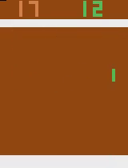
Pong

Slide 19
Pong
File "/opt/miniconda/lib/python3.7/site-packages/tensorflow/python/client/session.py", line 1149, in _run
str(subfeed_t.get_shape())))
ValueError: Cannot feed value of shape (4, 4, 4, 16) for Tensor 'default_policy/Placeholder_default_policy/conv1/kernel:0', which has shape '(8, 8, 4, 16)'
2021-08-25 15:51:15.470861: CPU Usage: 24.1%, Memory Usage: 6.0%, Memory Total/Available: 59074052096/55516184576
[2m[36m(pid=147)[0m /opt/miniconda/lib/python3.7/site-packages/tensorboard/compat/tensorflow_stub/dtypes.py:541: FutureWar

Slide 20
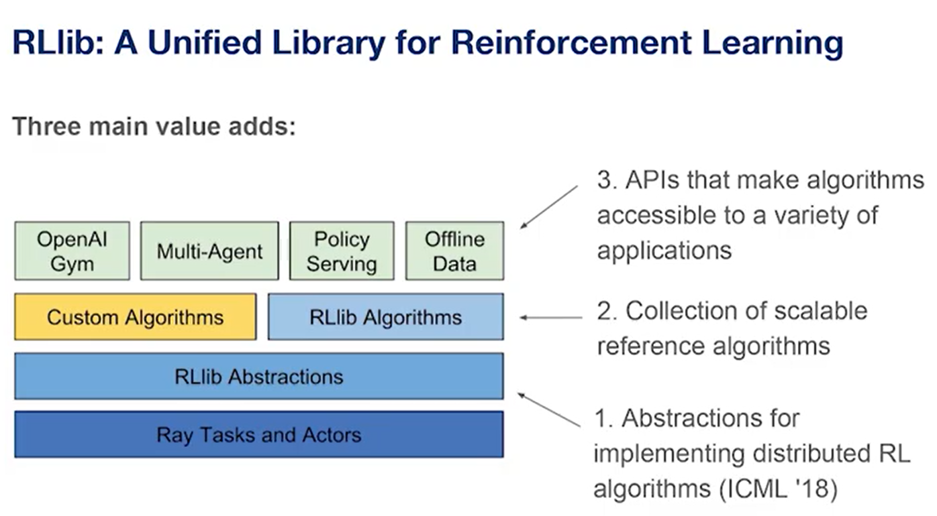
RAY

Slide 21
Reinforcement Learning (eventuell aus dem ML Kurs was rauskopieren)

Slide 22
Deep Learning
Hier das Beispiel mit Gradient Descent raussuchen (Deep learning for Vision)

Slide 23
Hands on -> Beispiel aus dem Buch
https://gym.openai.com/
Install with
pip install gym
pip install keras

Slide 24
https://techcommunity.microsoft.com/t5/azure-ai/introducing-reinforcement-learning-on-azure-machine-learning/ba-p/1403028
https://github.com/Azure/MachineLearningNotebooks/tree/master/how-to-use-azureml/reinforcement-learning
https://github.com/ray-project/ray

Slide 25
Issues I ran into
For the cartpole rl on sc demo I had some missing python packages in the docker image (resulting in an error when trying to capture the video) -> fixed this in a fork of the repo and created pull request
Missing Azure CLI for the Atari Distributed pong Demo
Install the Azure CLI for Windows | Microsoft Docs

